Slide 1
Towards Elastic Scalability
Peter Ritchie

Slide 2

Peter Ritchie
Software industry for over 26 years
Software Architect: Quicken Loans
Written three books
Visual Studio 2010 Best Practices
Refactoring with Microsoft Visual Studio 2010
Practical Visual Studio 2015
Microsoft MVP: Visual Studio and Development Technologies (C#)
PeterRitchie@QuickenLoans.com
@peterRitchie

Slide 3

Only 50 Minutes!
Slides:
http://bit.ly/TES-slides
Questions
Stop me

Slide 4
Agenda
What is elastic scalability
Roadblocks
Avoiding Roadblocks
Long Term
Strategies
Q&A, References

Slide 5
What is elastic scalability?

Slide 6
Elastic Scalability
Scalability
Ability of system to increase output as hardware resources are increased.
Scale out (horizontal): scale to more nodes or more hardware
Elasticity
To dynamically add resources based on changing conditions or criteria.
Ability for a system to detect increased workload and scale out to dynamically added resources.

Slide 7
Towards?
Multiple ways to scale
Accounts for future need
Does not predict specific needs
Evolve over time
Notes:
Why did I use the word “towards”?

Slide 8
Roadblocks
Notes:
What can stop software from being elastically scalable

Slide 9
Roadblocks to Elastic Scalability
Dependencies on specific servers
Dependencies on specific connections
Dependencies on specific data (versioning)
Statefulness
Lack of robustness
Lack of fault tolerance
What is doing what, when, and where?
Lack of knowledge of health

Slide 10
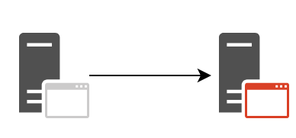
Dependencies on Specific Servers
Notes:
By URL, etc.

Slide 11
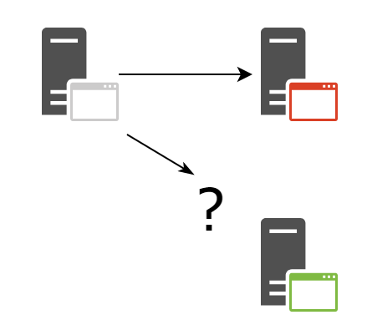
Adding another server?
Notes:
If I want to scale out one side, how does that effect a tightly-coupled client? Server, needs to know about new URL or know how to pick which URL to use, if state is in memory, where does that state go?

Slide 12
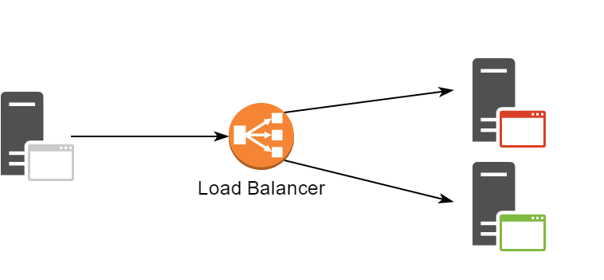
One solution
Notes:
Set up load balancer with top-level name that off-loads to other servers that it is configured knows about

Slide 13
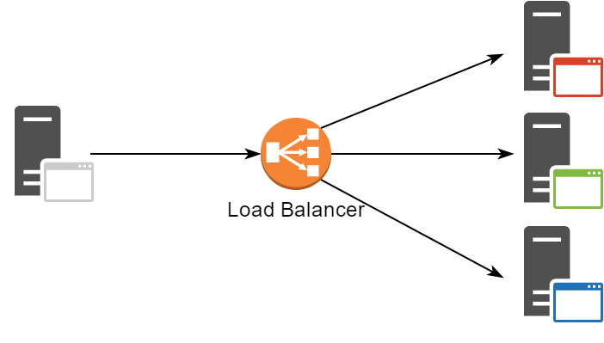
More servers

Slide 14
Goals
100 % Automated deployment
100% uptime
deploying components one instance at a time
Multiple (usually two) versions running at a time
A fine granularity of what can be deployed independently
Avoiding “microliths”
Metrics to decide when to scale out and in
Health: differentiate between compensable and fatal
Load: amount of work that can be done and is being done
Designed to support deployments not known at design-time

Slide 15
Avoiding Roadblocks

Slide 16
Beyond Round-Robin
Distribute work based on load is more efficient
Requires “load” to be known or calculated
Shared/containerized environments, “load” is service-specific
Report load for each service/application.

Slide 17
Logging
Things to log
Contexts
Per task
Per request
Date & time
Cost (completed log entries)
Failed Assertions
Exception
Differentiate between errors/exceptions compensated for.

Slide 18
Configuration
App.config may not make sense
Centralized configuration
Scaling out pushes unique configuration
Etc…

Slide 19
Service Resolution
Invocation of other services
Invocation via abstraction, like name

Slide 20
Service Resolution Alternatives
Load balancer
Platforms
Service Fabric
Frameworks

Slide 21
Stateless
“State” is only in-memory state
Problems with stateful
State couples execution to that specific process and sometimes thread
If long-running or asynchronous, must return to the one process
No scaling
Being stateless
Deferring state to some persistence mechanism for other instances to retrieve

Slide 22
Versioning

Slide 23
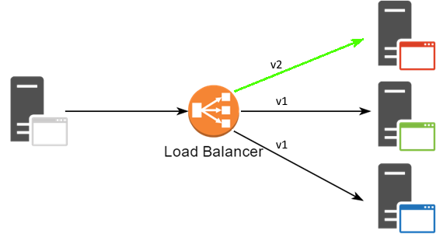
Versioning

Slide 24
Long Term

Slide 25
Composability
Separating concerns
Being composable
Service-oriented
Microservice-oriented
Message-oriented/event-driven
Composability all the way down

Slide 26
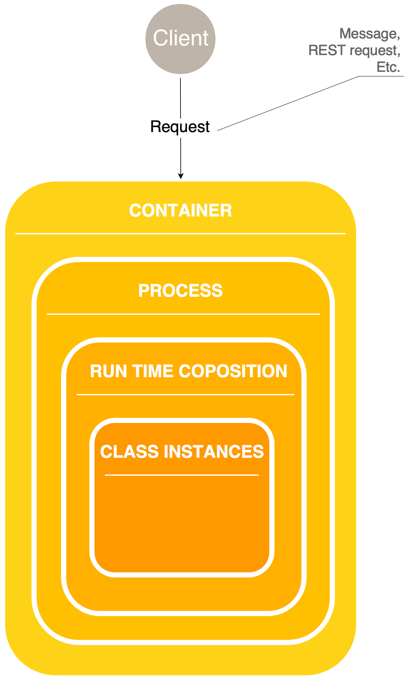
Compose all the way down

Slide 27
Other considerations
Secrets
Often stored locally, may need to be centralized and more security added.

Slide 28
Strategies

Slide 29
SOLID
Single Responsibility
Open-Closed
Liskov Substitution
Interface Segregation
Dependency Inversion

Slide 30
Service-Oriented Architecture (SOA)
Service “contract”
Autonomy
Composable
Abstraction, encapsulation, reusability.
Discoverability
Statelessness
Microservices

Slide 31
Domain Driven Design (DDD)
Ubiquitous language
Bounded contexts
Continuous Integration
Model-Driven
Patterns
Entity & Value Objects
Aggregates (consistency/atomicity boundary)
Events
Repository

Slide 32
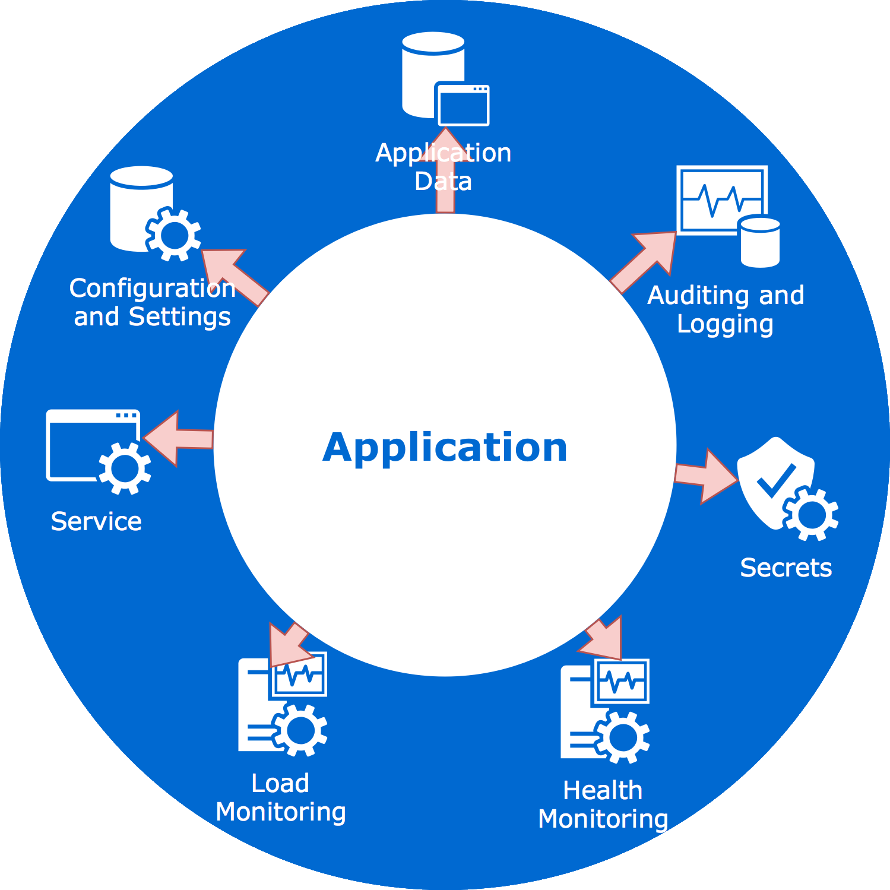
Separation of Concerns

Slide 33
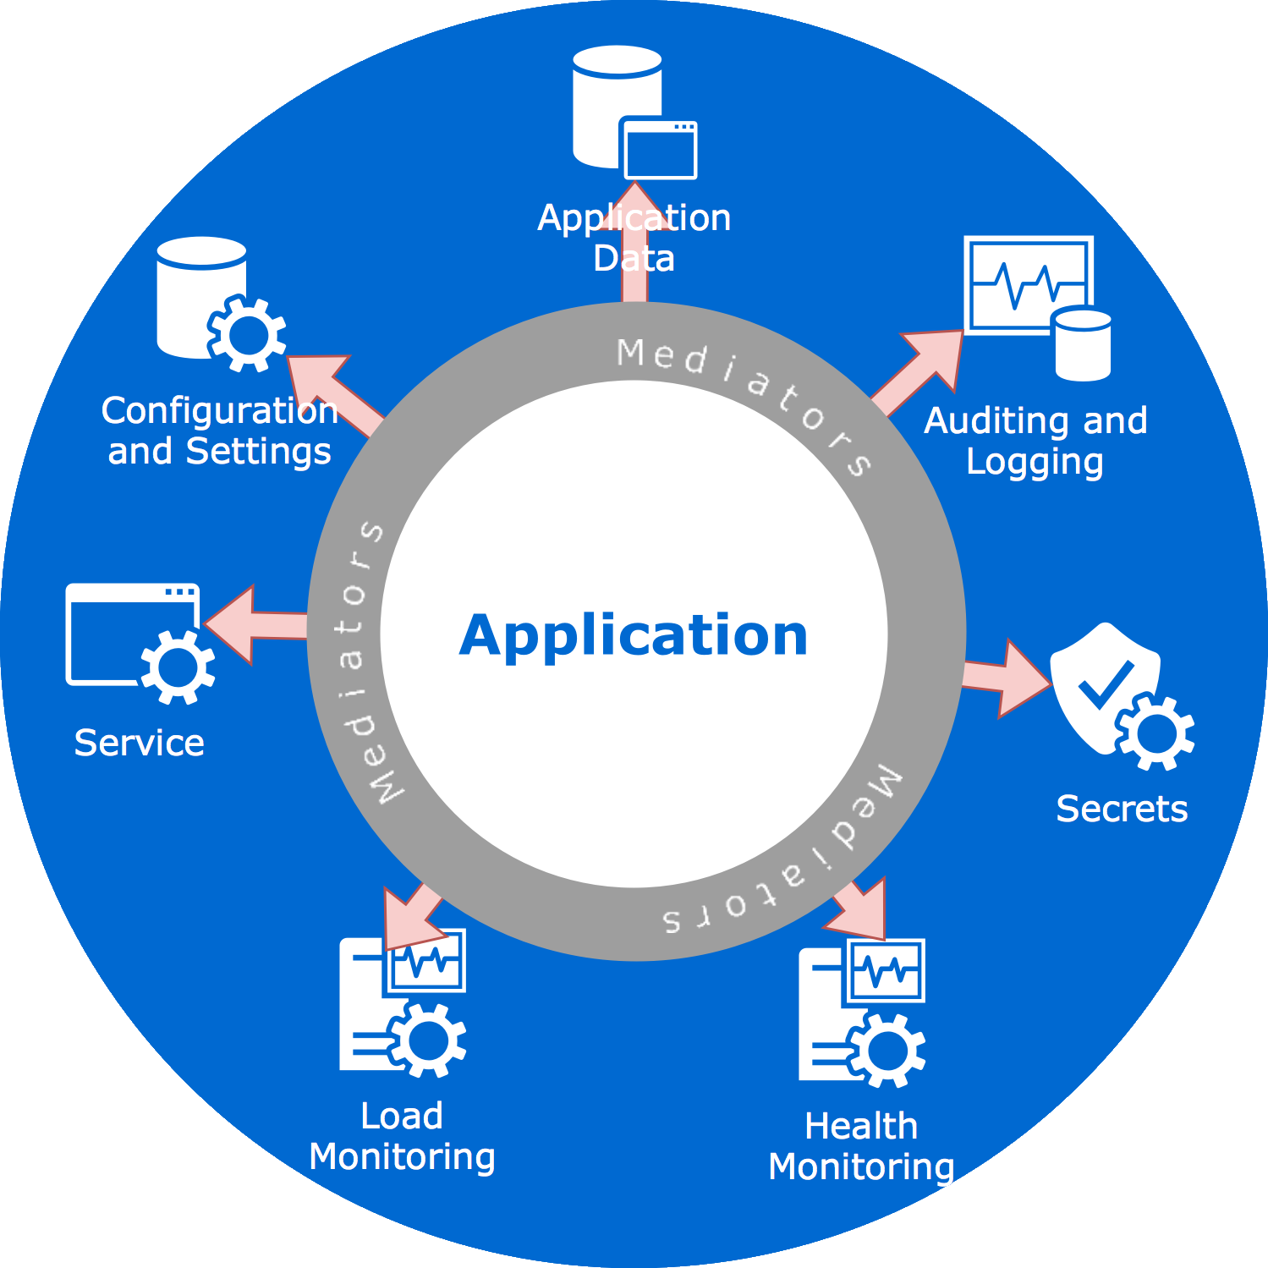
Mediating Concerns
Notes:
Autonomy, dependency inversion, single responsibility, abstraction, encapsulation

Slide 34
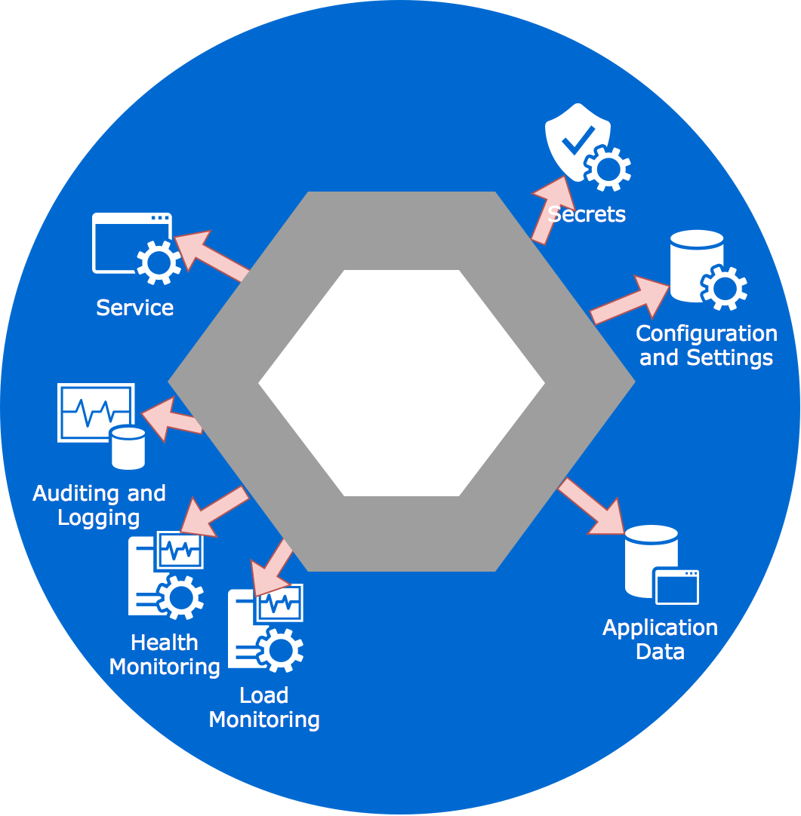
Hexagonal Architecture

Slide 35
Hexagonal Architecture
“Ports and Adapters”
Adapters == Mediators
Ports == Group of interfaces
1 to 6 edges for “port”
Ports:
Interface with the user
Database
Maybe administration interface
Maybe 3rd party services.
Etc.

Slide 36
Hexagonal Architecture
Left side: application internals
Directly tested by unit, integration, automated tests
Right side: external connections
Mocks/Doubles used in various stages of testing

Slide 37
Actor Model
About work breakdown
Each actor perform task
One actor per task
Actor receives message
Decoupled from communications methods
Can send 1 or more message
Can create new actors
Can respond to same messages differently

Slide 38
SAGAS
Long-running “Transaction”
Not “atomic”
Compensatory
Reverses or undoes actions
Important when work is broken down into smaller chunks
Across processes
Across services

Slide 39
“Services”
Not just RESTful
Message-oriented
Hybrid
Etc.

Slide 40
Questions?

Slide 41
Thank You!

Slide 42
References
https://steeltoe.io/ (.NET version of Spring Cloud)
http://bit.ly/TES-slides
http://getakka.net/
http://bit.ly/SeFaActors
http://bit.ly/SeFaServices
Tomorrow: Introduction to…Service Fabric Marquette A
PeterRitchie@QuickenLoans.com
@peterRitchie

